Slide 1


Department of Electronics and Communication Engineering
Govt. Sri Krishnarajendra Silver Jubilee Technological Institute
K R Circle, Bengaluru -560001
(Affiliated to VTU, Belagavi & Approved by AICTE, New Delhi)
Project Presentation
on
“Intelligent Driver Assistance System”
Presented by
Lokesh V 1SK13EC017
Shreyas M 1SK13EC054
T Rakesh 1SK13EC058
Under the Guidance of
Prof. MAMATHA R
Assistant Professor
Dept. of ECE

Slide 2
Abstract
Now a days people are driving recklessly, due to which many incidents occur frequently.
So in order to avoid such kind of incidents and to alert the drivers in such kind of places, the traffic police department have placed the signboards.
But sometimes it may not be possible to view those signboards and there is a greater chance of incidents. Most incidents occurring on road is due to Traffic sign miss out, Speeding at restricted places and Overtake without judgement.
Hence, in our project we propose a prototype for these problems, i.e. Electronic Model.

Slide 3

OVERVIEW
Introduction.
Literature Survey.
Case Study.
Problem Statement.
Solution.
Components and Tools.
Working.
Flowchart.
Implementation.
Results.
Future Scope.
Conclusion.
References.

Slide 4
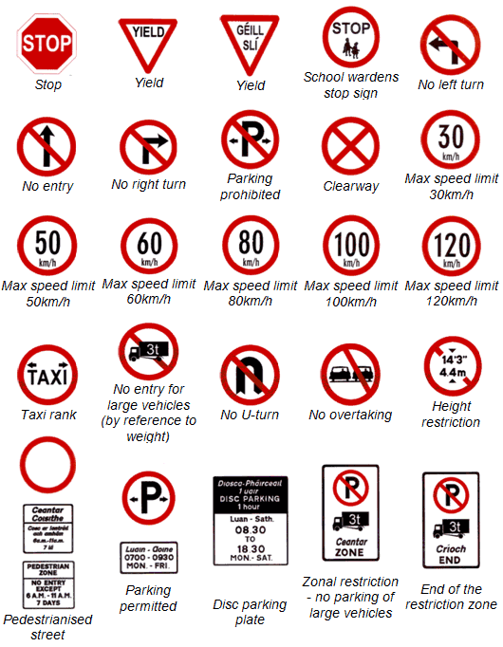
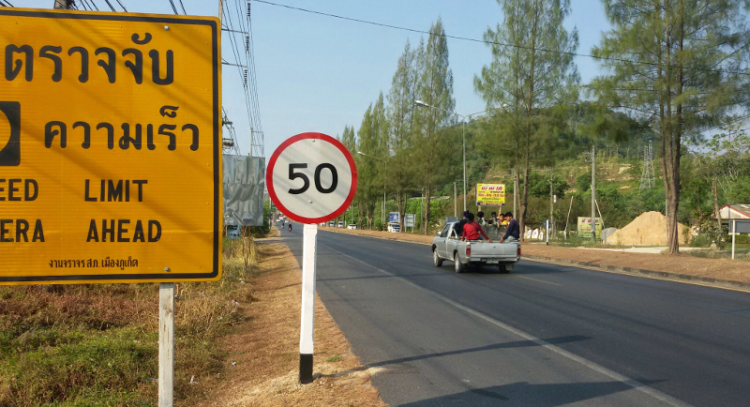
Introduction – Case 1
Traffic Sign Recognition is a technology by which a vehicle is able to recognise the traffic signs put on the roads e.g. "speed limit" or "turn ahead“ etc.. This is part of the features collectively called ADAS. The technology is being developed by many automotive suppliers, including Continental and Delphi.
The first case of the project is to detect and recognize traffic signs.
Traffic Sign Recognition (TSR) is used to regulate traffic signs, warn a driver, and
command or prohibit certain actions.

Slide 5
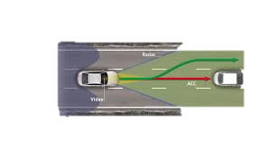
Introduction – Case 2 & 3
2. Intelligent Speed Adaptation (ISA), is a system that ensures that vehicle speed does not exceed a safe or legally enforced speed. In case of potential speeding, a human driver can be alerted, or the speed reduced automatically.
In second case, is to design and develop a new system that can effectively
detect speed limit on the road and supports the driver to obey traffic rules while
driving by maintaining the speed of vehicle according to the speed limit
prescribed by particular zone.
3. Overtaking assistance:
This project assists the driver in overtaking manoeuvres. In order to do that, the application must indicate whether it is safe or not to perform the overtaking manoeuvre.
To propose this application, concepts of kinematics techniques are used to model the overtaking manoeuvres and the successful simulation results show this technique to be promising.
The system gives information of relative speeds, vehicle speed, OSD etc. to driver on the display. It suggests the driver if it’s safe to overtake or not; if so at what speed.

Slide 6
Literature Survey
Traffic sign detection in dual-focal active camera system.
In this, a dual-focal active camera system is proposed to obtain a high resolution image of traffic sign. In the system an active telephoto camera is equipped as an assistant of a wide angle camera.
Development and evaluation of in-vehicle signing system utilizing RFID tags as digital traffic signs.
Vehicle drivers are requested to collect dynamic visual information on such matters as other vehicles and traffic signals, and static visual information including traffic signs, and to manoeuvre the vehicle accordingly.
An RFID-based intelligent vehicle speed controller using active traffic signals.
Communication we present a new Infrastructure to Vehicles (I2V) communication and control system for intelligent speed control, which is based upon Radio Frequency Identification (RFID) technology for identification of traffic signals on the road, and high accuracy vehicle speed measurement with a Hall effect-based sensor.
Traffic sign detection using Image Processing
This project proposes algorithms for the automatic detection of traffic signs from photo or video images and
their classification to provide a driver alert system.

Slide 7
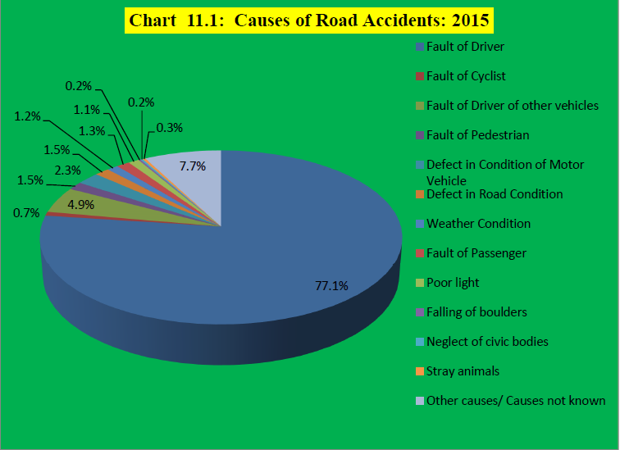
Case Study
Courtesy: Ministry of Road Transport & Highway, Law Commission of India ( 2016)

Slide 8
Problem Statement
Drivers miss out the Traffic sign reading due to the disturbances on roads or due to non-attentiveness while driving or due to the absence of mind.
In the monsoon and rainy seasons, the sign might not be seen due to fog and rain.
Most of the accidents that occur near the schools or restricted sites are due to over speeding of vehicle, i.e. accelerating above the speed limit.
Present technology limits a maximum speed in every zone but sometimes this might not be useful on highways, etc..
Overtaking without judgment and idea about front running vehicle’s safe distance causes collision accidents.
The amateur drivers miss to visualize the bumper clearance and hence would lead to collisions.
In this project, we address these 6 problems and propose solution for the same.
Notes:
Wavelength is more for auidiable range, so directivity is less hence the beam angle increases

Slide 9
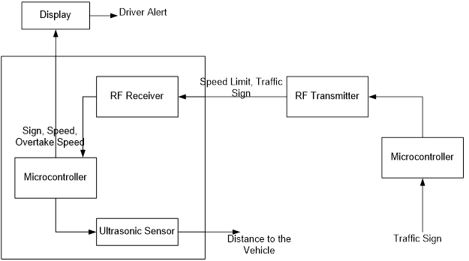
Solution
Audio Alert
Recover End (Inside CAR) Transmitter End (Boards on ROADs)

Slide 10

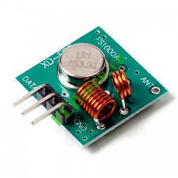
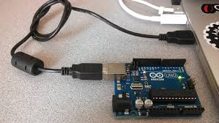
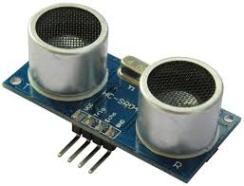
Components and Tools
Hardware
Monitor : 15 inch color display
Device Side : 2 Arduino microcontroller board RF 433 MHZ Transmitter and Receiver Ultrasonic Sensor Serial Cable DC Motor
Software (Tools &Technologies)
Platform : Arduino
Language : C/C++
IDE/Tool/GUI : MatLab

Slide 11
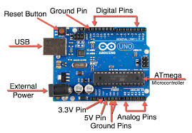
Arduino
The Arduino Uno is a microcontroller board based on the ATmega328. Arduino is an open-source, prototyping platform and its simplicity makes it ideal for hobbyists to use as well as professionals.
The Arduino Uno has 14 digital input/output pins , 6 analog inputs, a 16 MHz crystal oscillator, a USB connection, a power jack, an ICSP header, and a reset button. Connect it to a computer with a USB cable or power it with a AC-to-DC adapter or battery to get started.
Features of the Arduino UNO:
Microcontroller: ATmega328
Operating Voltage: 5V
Digital I/O Pins: 14 (of which 6 provide PWM output)
Analog Input Pins: 6
DC Current per I/O Pin: 40 mA
Flash Memory: 32 KB of which 0.5 KB used by bootloader
SRAM: 2 KB (ATmega328)
EEPROM: 1 KB (ATmega328)
Clock Speed: 16 MHz

Slide 12
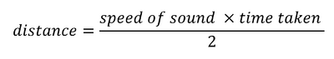
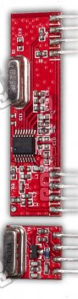
Other Components
The RX – ASK is an ASK Hybrid receiver module. It is a effective low cost solution for using 433 MHz. The TX-ASK is an ASK hybrid transmitter module.
An Ultrasonic sensor is a device that can measure the distance to an object by using sound waves. It measures distance by sending out a sound wave at a specific frequency and listening for that sound wave to bounce back. By recording the elapsed time between the sound wave being generated and the sound wave bouncing back, it is possible to calculate the distance between the sonar sensor and the object.
Features
Range in open space(Standard Conditions) : 100 Meters
RX Receiver Frequency : 433 MHz
RX Typical Sensitivity : 105 Dbm
RX Supply Current : 3.5 mA
RX IF Frequency : 1MHz
RX Operating Voltage : 5V
TX Frequency Range : 433.92 MHz
TX Supply Voltage : 3V ~ 6V

Slide 13
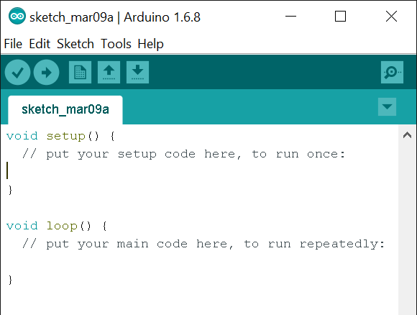
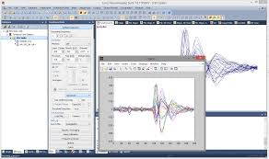
Arduino IDE and MATLAB
A minimal Arduino C/C++ sketch, as seen by the Arduino IDE programmer, consist of only two functions:
setup(): This function is called once when a sketch starts after power-up or reset. It is used to initialize variables, input and output pin modes, and other libraries needed in the sketch.
loop(): After setup() has been called, function loop() is executed repeatedly in the main program. It controls the board until the board is powered off or is reset
MATLAB (matrix laboratory) is a multi-paradigm numerical computing environment and fourth-generation programming language. A proprietary programming language developed by MathWorks, MATLAB allows matrix manipulations, plotting of functions and data, implementation of algorithms, creation of user interfaces, and interfacing with programs written in other languages, including C, C++

Slide 14
Working
Case 1:
The Traffic signs are sent as Radio Signal using RF transmitter. The sign encoded is transmitted in regular intervals.
Vehicles are equipped with a receiver block will receive this encoded radio signal,
This received data is decoded and the output is displayed on the display and a audio alert of the sign is provided to Driver.
Case 2:
The speed limit on that road is sent as radio signal and the vehicle will receive this radio signal.
The speed limit is displayed and a resultant action would be taken based upon the current speed.
The action will be informed to the driver.

Slide 15
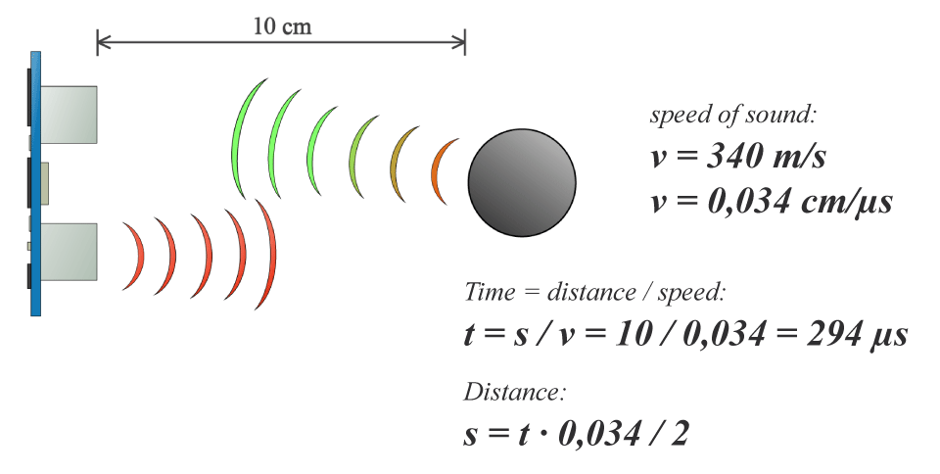
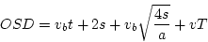

Case 3:
Ultra-sonic sensor is fit in front of vehicle and they measure the distance to front running vehicles.
Based on this distance and using predetermined formula, it assists the driver if its safe to overtake or not along with the amount of acceleration to be applied and Overtaking Sight Distance(OSD).
The Width of the
front car
Wdist=$\sqrt{(d^{2}}+5^{2})$
Distance the front vehicle
Wanted Distance
to cover while overtaking i.e. to be safe

Slide 16
Flowchart
Case 1 & 2

Slide 18
Flowchart
Case 3

Slide 20
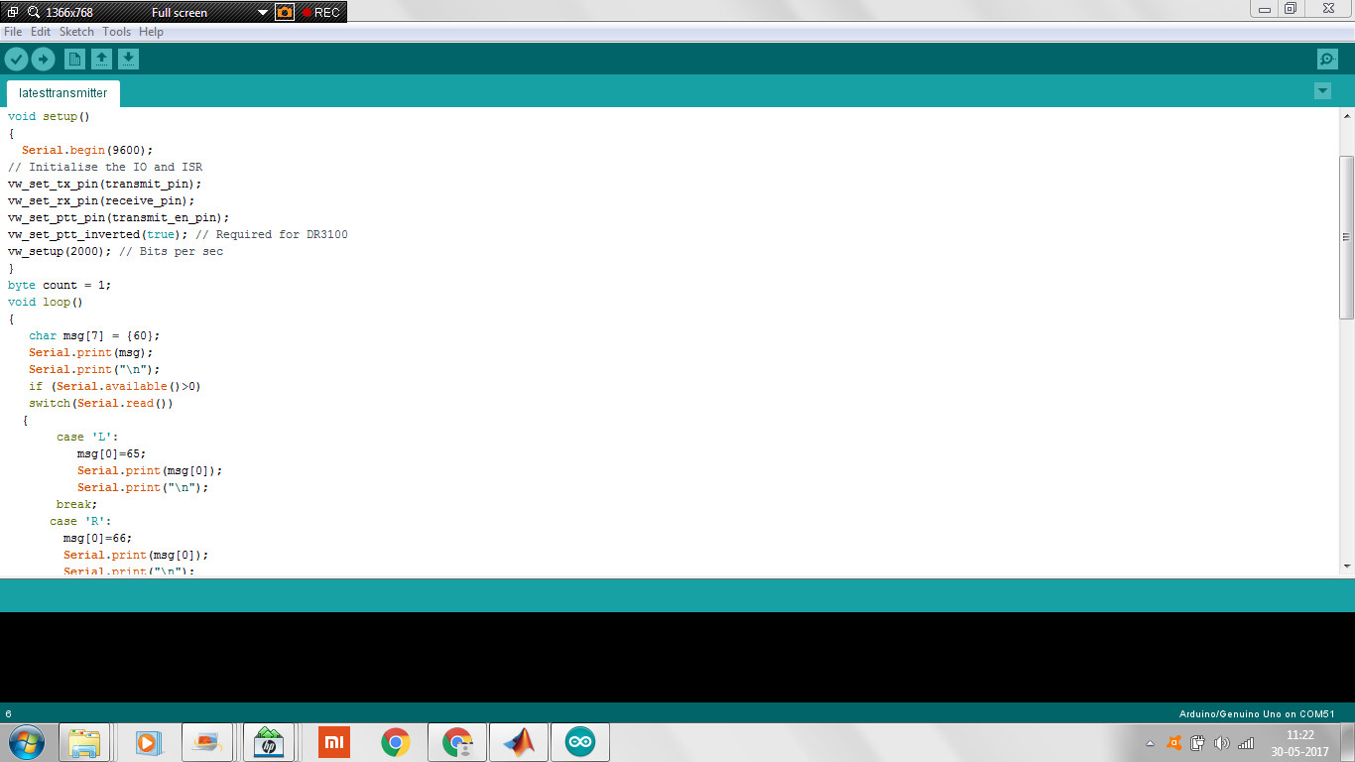
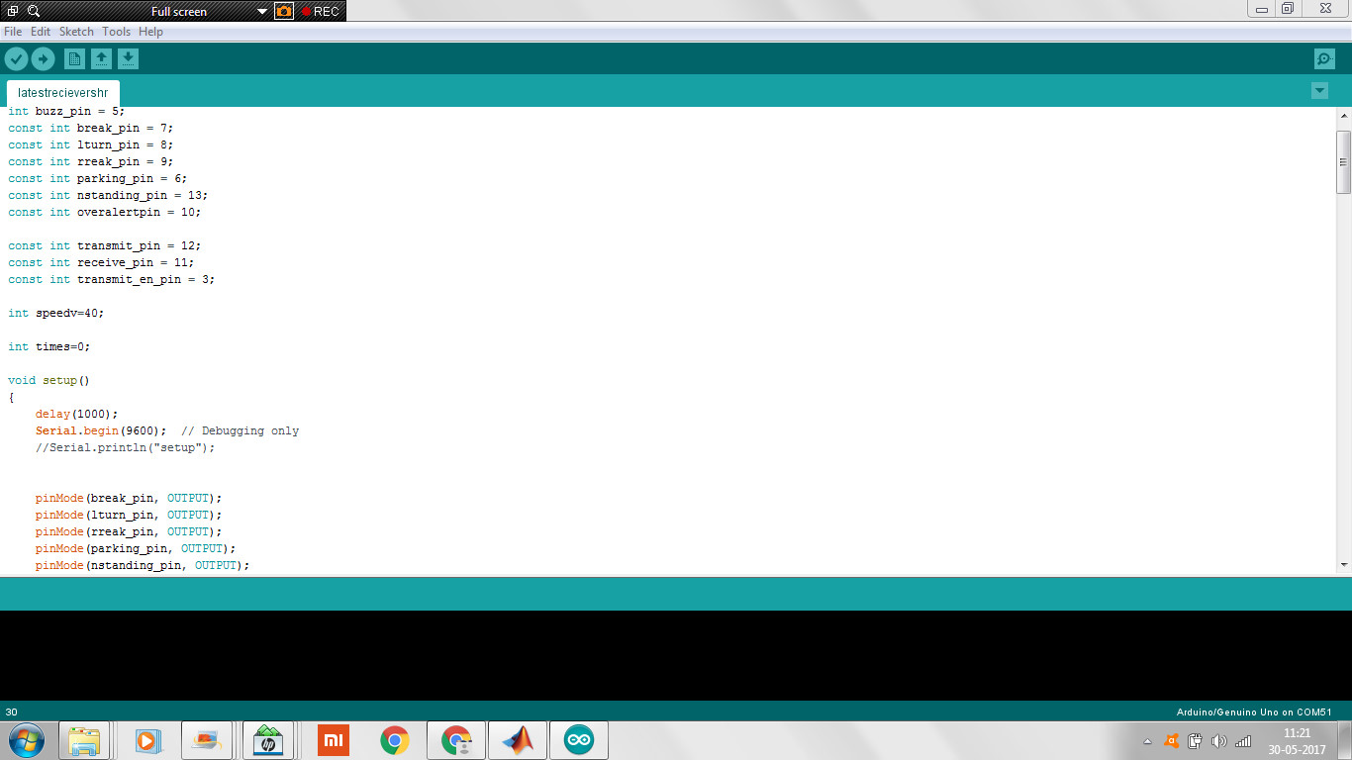
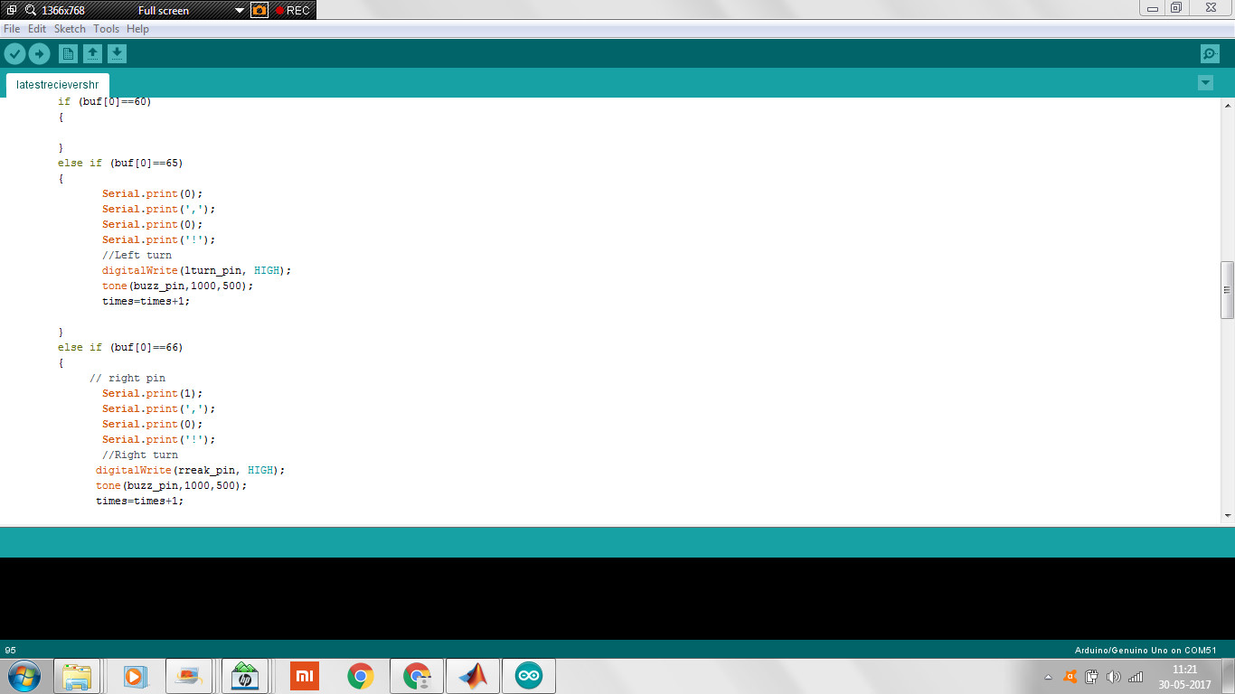
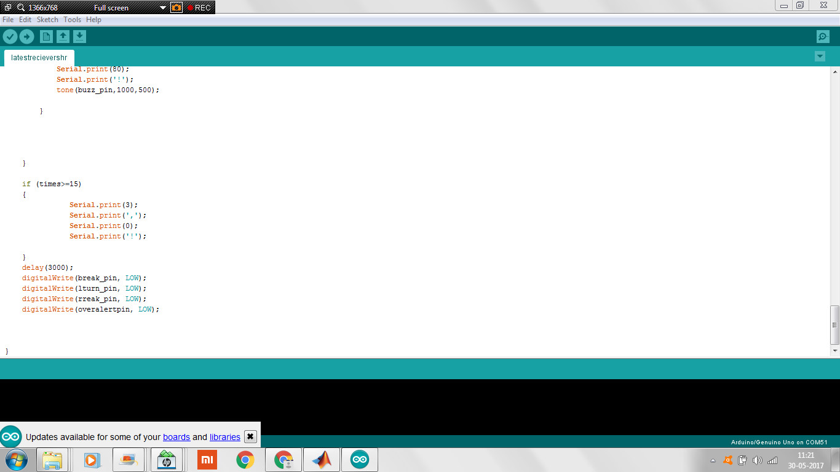
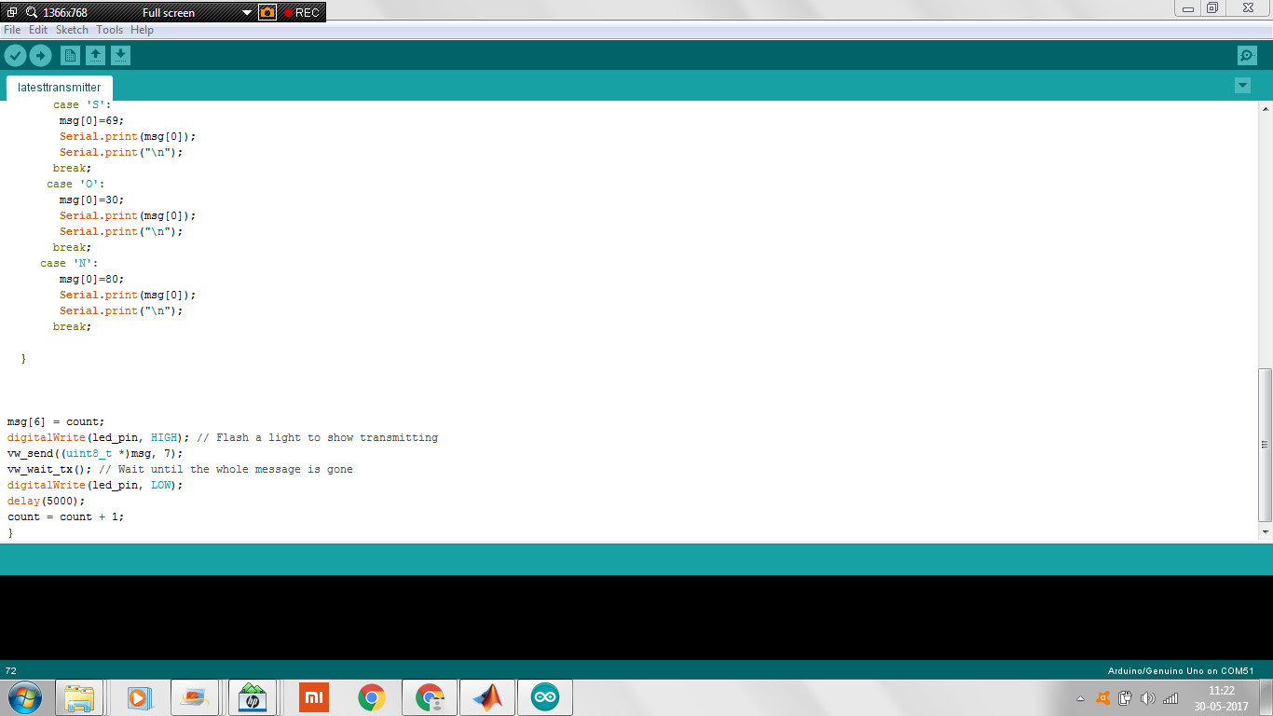
Implementation Case 1 & 2 - Coding

Slide 21

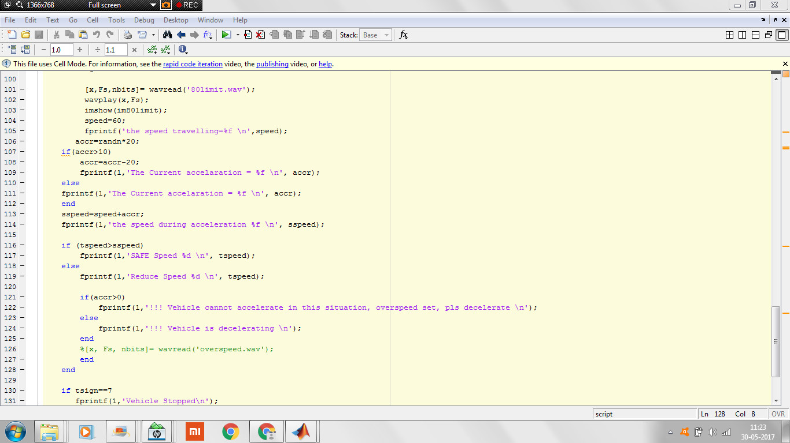

Slide 22
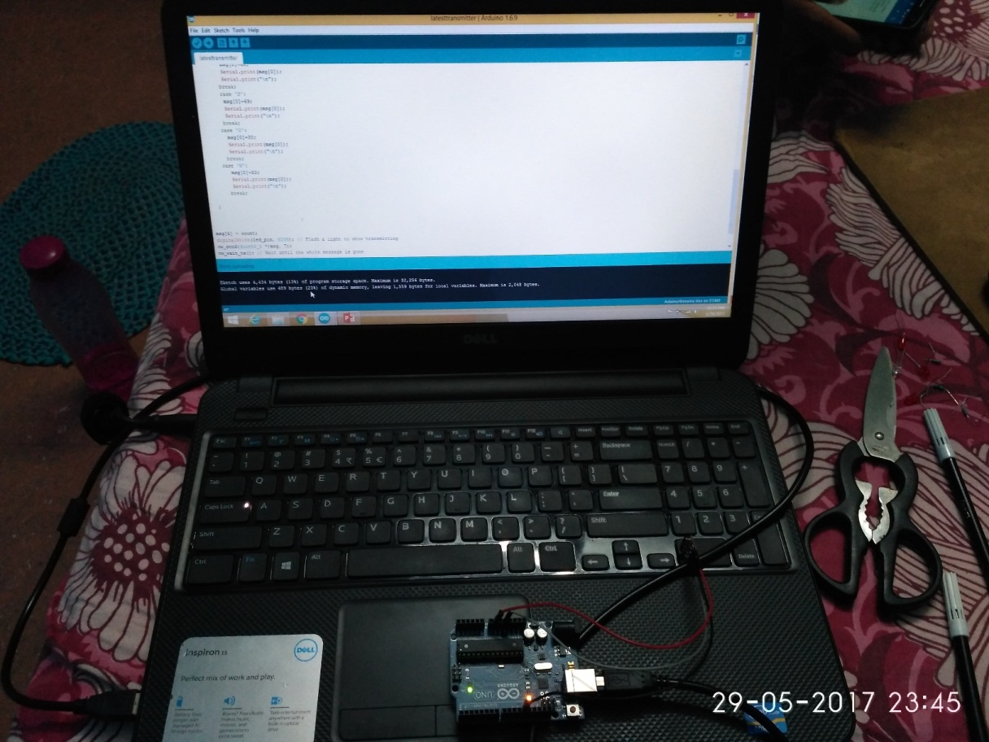
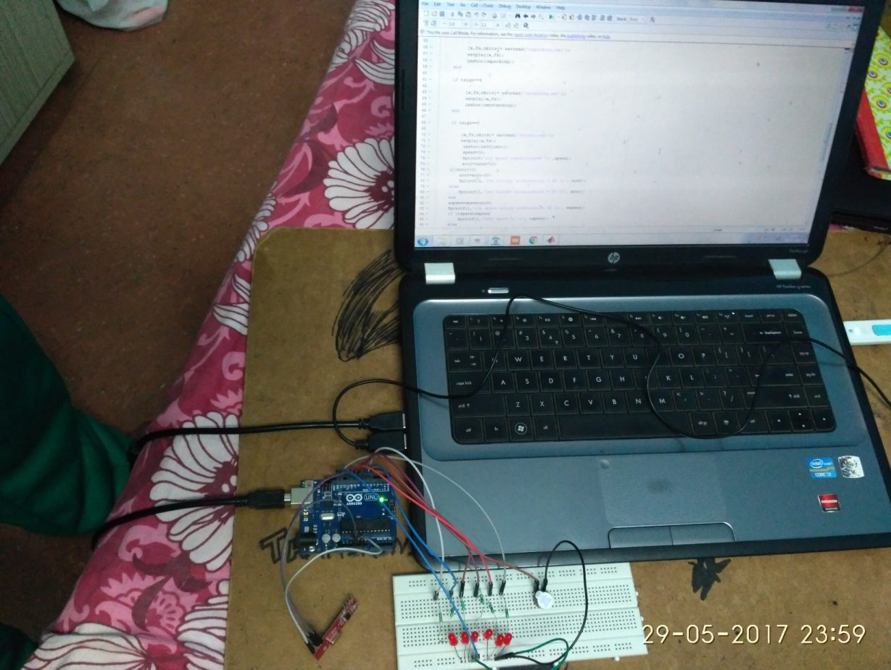
Implementation Case 1 & 2 - Snapshots
Transmitter Reciever

Slide 23
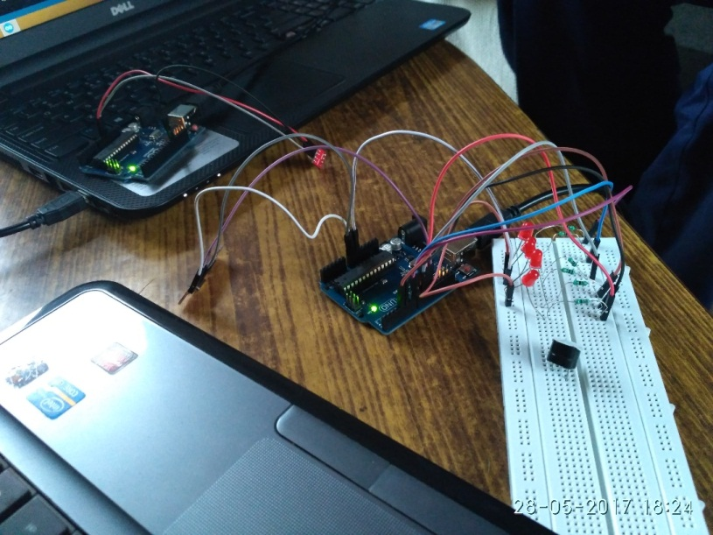
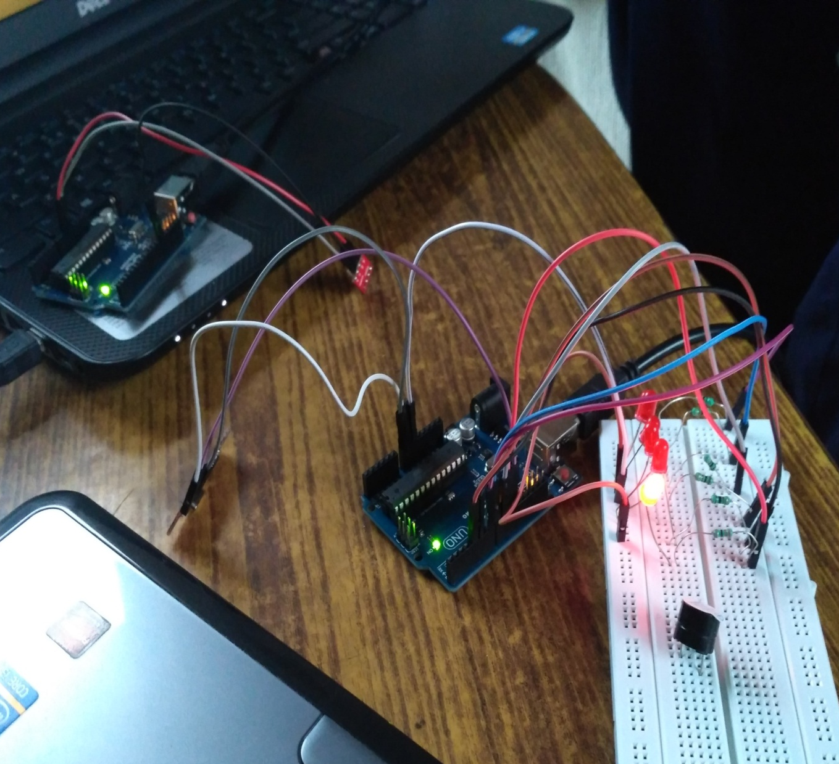
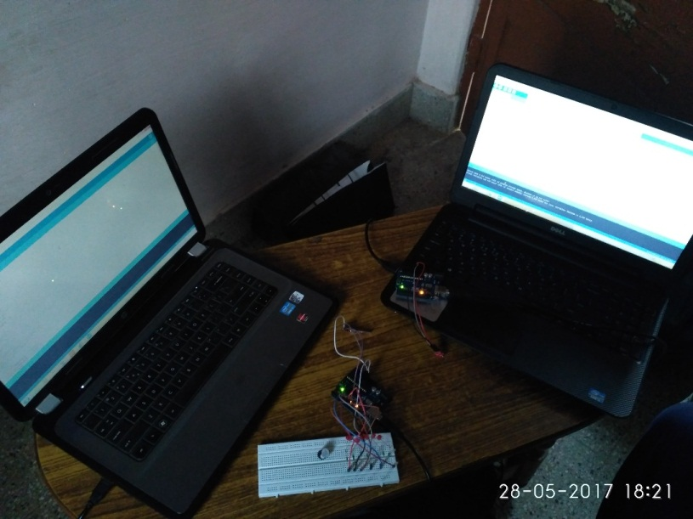

Slide 24
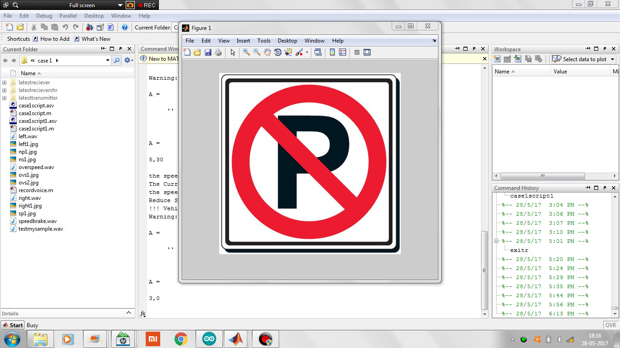
Results – Case 1

Slide 25
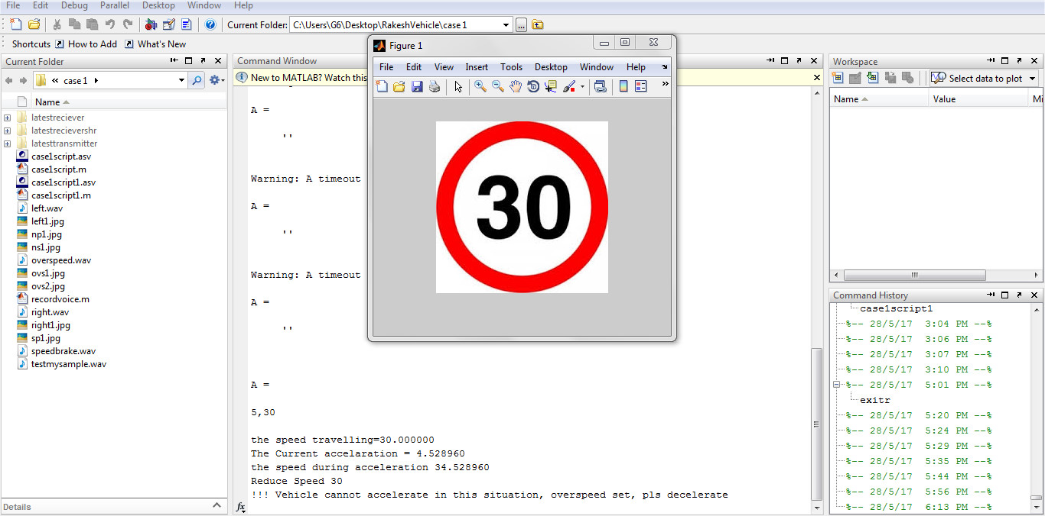
Results – Case 2

Slide 26
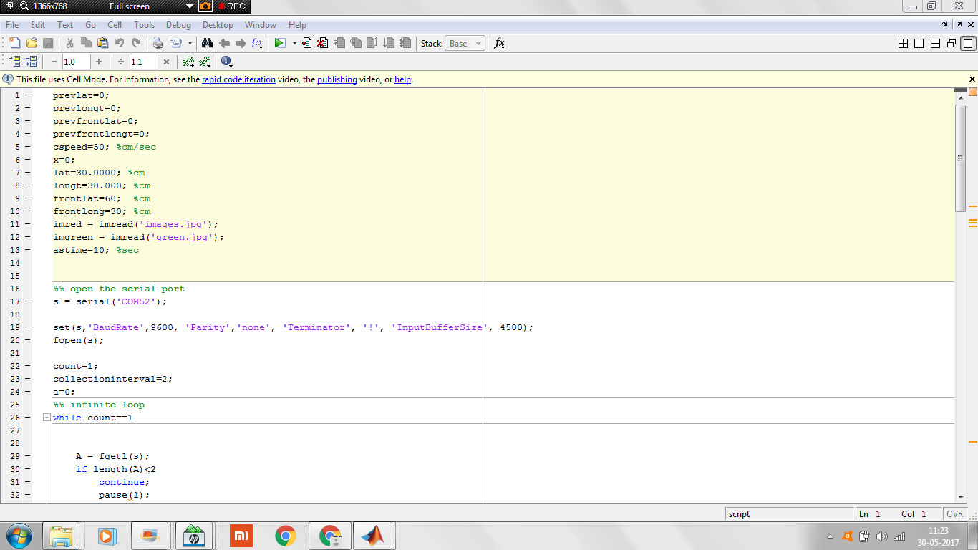
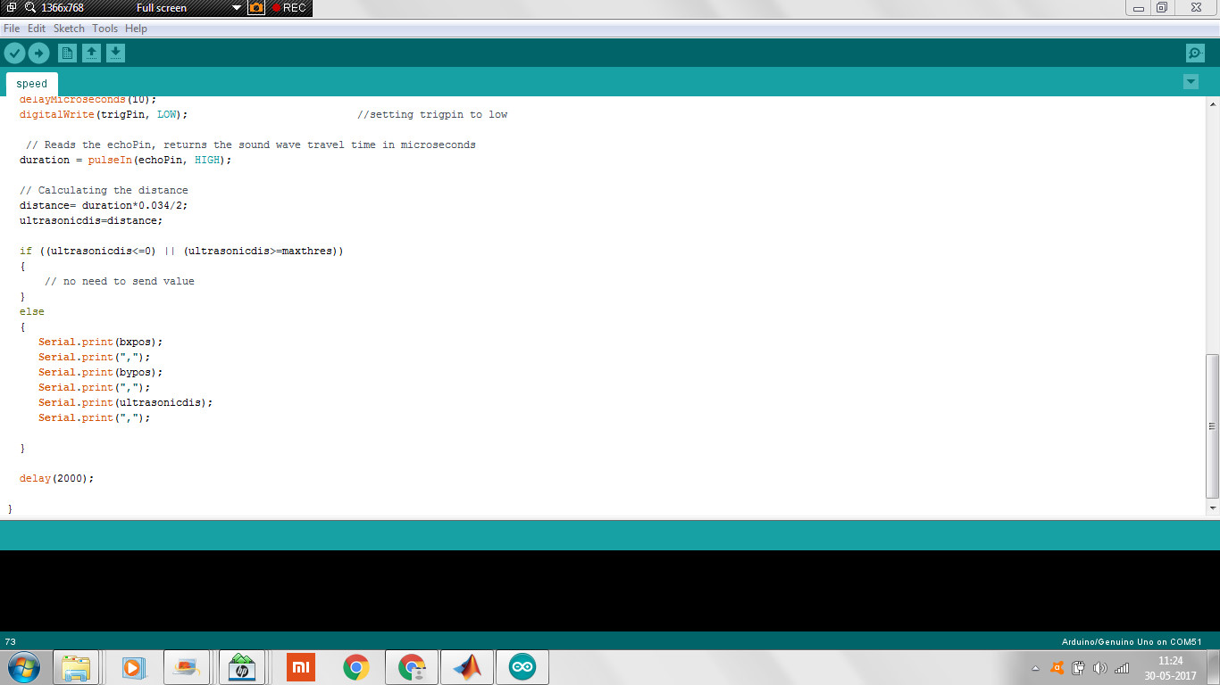
Implementation Case 3 - Coding

Slide 27
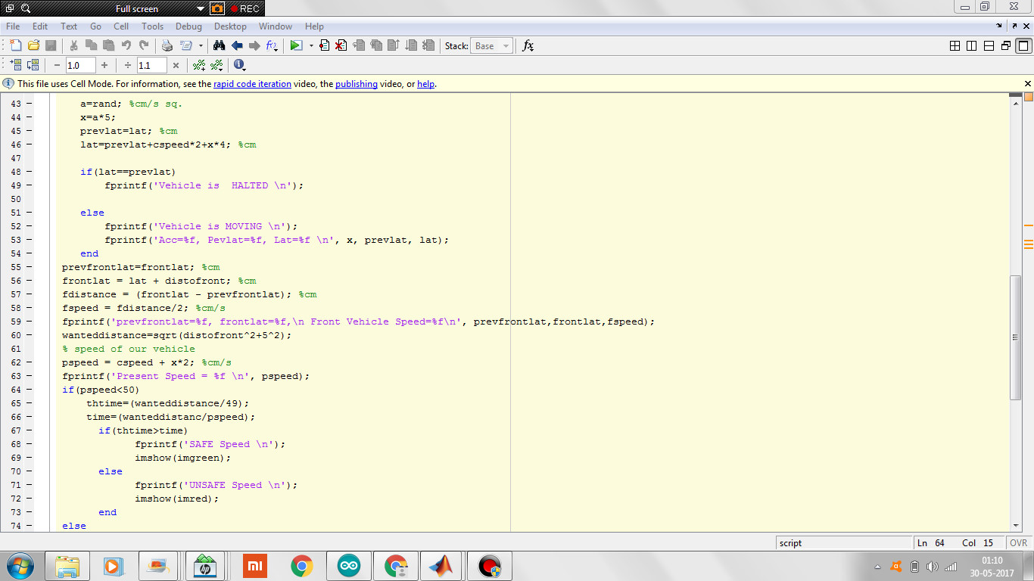


Slide 28
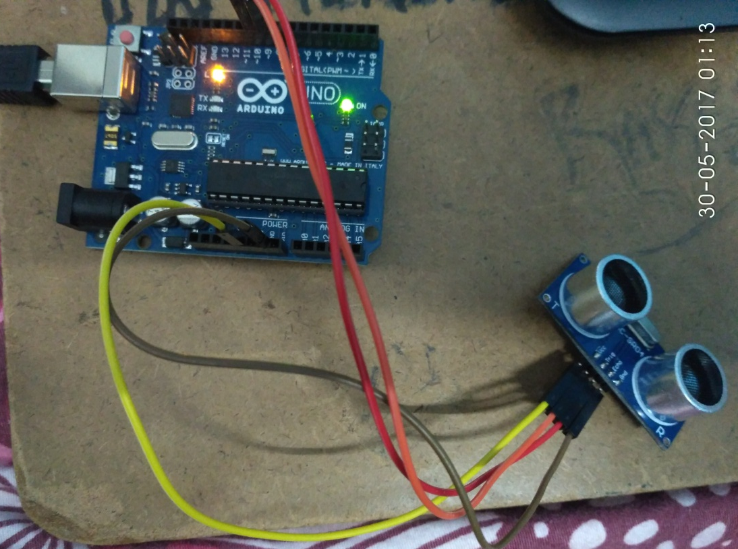
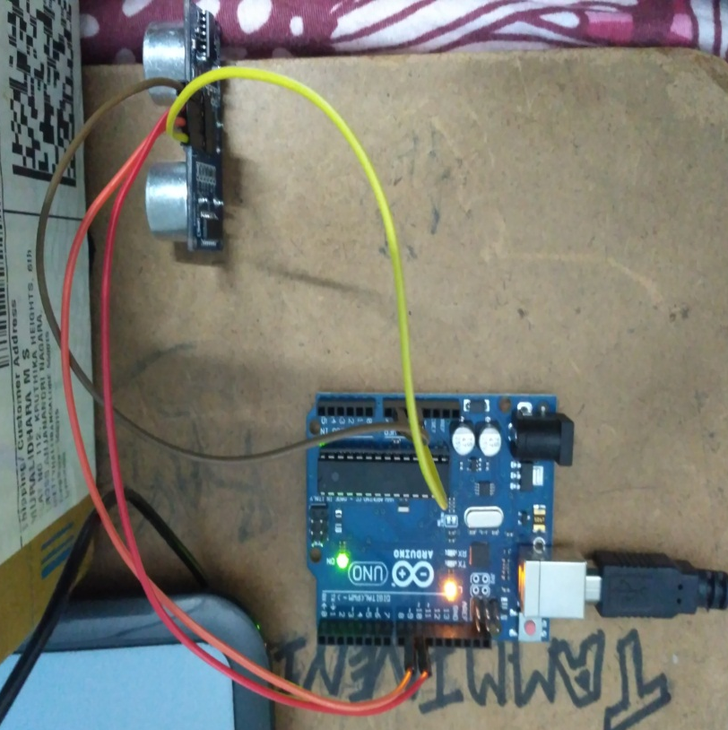
Implementation Case 3 - Snapshots

Slide 29
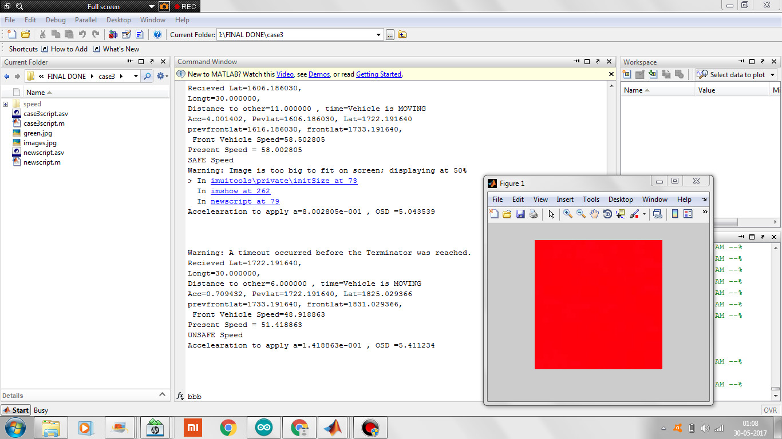
Results – Case 3

Slide 30
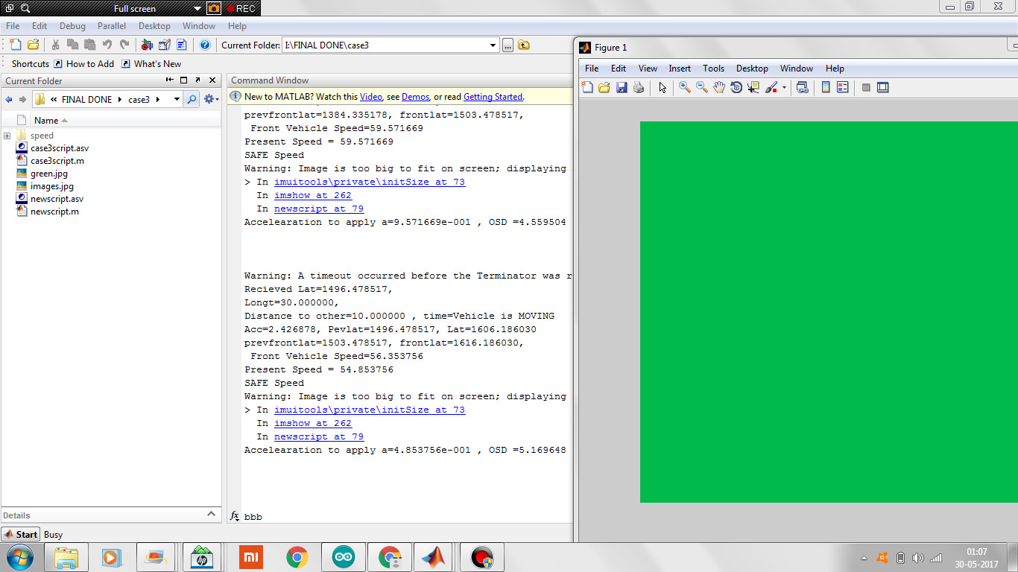

Slide 31
Advantages
1.The amount of accidents caused due to negligence and ignorance will reduce.
2.Irrespective of the climatic and seasonal conditions this would be of a great use.
3.The maintenance cost will decrease.
4.The cost of implementation will decrease.
5.The accidents caused due to immaturity in driving and overtaking will decrease.
6.The system is made adaptable.
7.The voice commands will alert the driver in any situation.

Slide 32
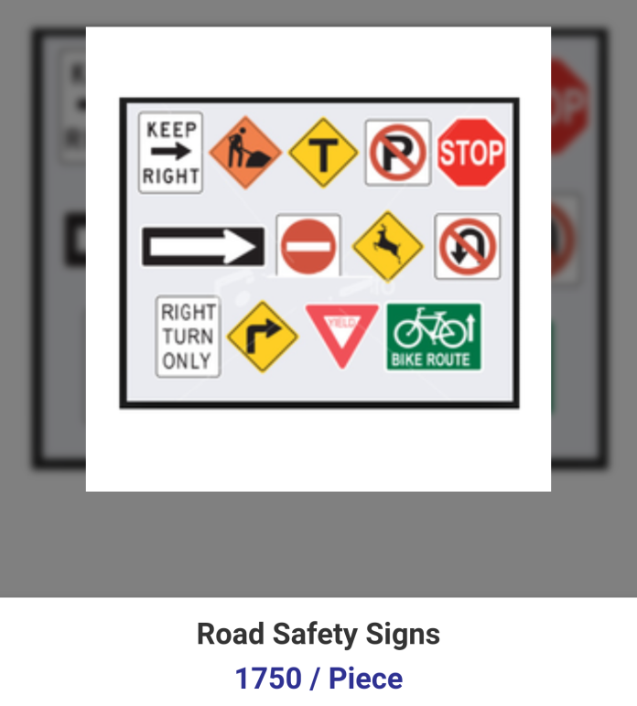
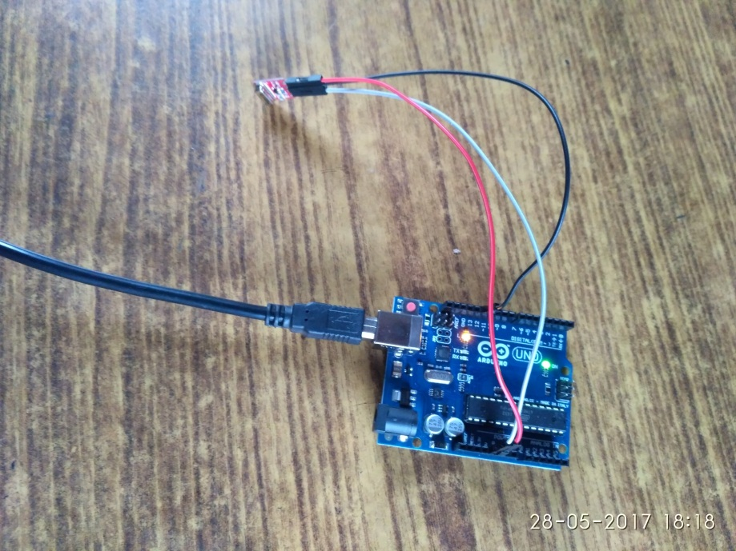
COST ANALYSIS
Overall cost of manual installation leads to Rs 2500 approx. per sign board incurred by the traffic police department.
Final product of our prototype would be Rs 1500 approx. per sign board installation. Lot implementation and installation will decrease the cost.
V/S

Slide 33
Future Scope
We have proposed this system to provide the driver assistance about the sign boards, speed and every relative movement of the vehicle., hence the vehicles on opposite lane shouldn’t be disturbed. Thus directive transmitter and receivers should be configured and standardised.
At different zones, the speed of the car should be mechanically limited based on the speed limit. Mechanical model is to be built based on the output of the system which shall act as automatic adaptive speed governor. Hence resulting in an electro-mechanical assistance system.
The system can be developed where it account the considerations of the vehicle coming on opposite lanes as well as coming from behind during overtaking decision. The system would be able to adjust if it is safe to overtake with all the parameters determined and considered.

Slide 34
Conclusion
We have proposed this system to provide the driver assistance about speed and every relative movement of the vehicle.
The System is implement for to provide the driver assistance when driver driving the vehicle on the road to avoid the damage of the vehicle; avoid over speeding at various zones; wrong parking or prevent parking violations; and premature driving while overtaking.
This part of the vehicle system is implemented by observing the scenario of the day today life. In future, various imaging algorithm can be used along to process the video stream while driving.
Collision avoidance can be complimented along with message alert to nearby police station/authorities and related persons in case of emergency or accidents.

Slide 35
References
Y. Gu, T. Yendo, M. Tehrani, T. Fujii and M.Tanimoto. 2011. “Traffic sign detection in dual-focal active camera system”, International Conference on Intelligent Vehicle Symposium, IEEE, pages 1054–1059.
Road sign recognition system based on GentleBoost with sharing features,Jin-Yi Wu; Chien-Chung Tseng; Chun-Hao Chang; Jenn-Jier James Lien; Ju Chin Chen; Ching Ting Tu, Proceedings 2011 International Conference on System Science and Engineering, Year: 2011,Pages: 410 – 415.
Robust traffic signs detection by means of vision and V2I communications. M. A. García-Garrido; M. Ocaña; D. F. Llorca; M. A. Sotelo; E. Arroyo; A. Llamazares 2011 14th International IEEE Conference on Intelligent Transportation Systems (ITSC), Year: 2011, Pages: 1003 – 1008
Pérez, Joshué, et al. "An RFID-based intelligent vehicle speed controller using active traffic signals." Sensors 10.6 (2010): 5872-5887
“Driver Assistance System Towards Overtaking in Vehicular Ad Hoc Networks” Antonio S. S. Vieira, Joaquim Celestino Jr. State University of Ceara (UECE) Computer Networks and Security Laboratory (LARCES), Fortaleza, Ceara. Ahmed Patel, Mona Taghavi, Faculty of Information Science and Technology University Kebangsaan Malaysia Software Technology and Management Research Center (SOFTEM), Selangor, Malaysia.

